Slide 1

“Food Delivery Website and Application”
Task - 2

Slide 2
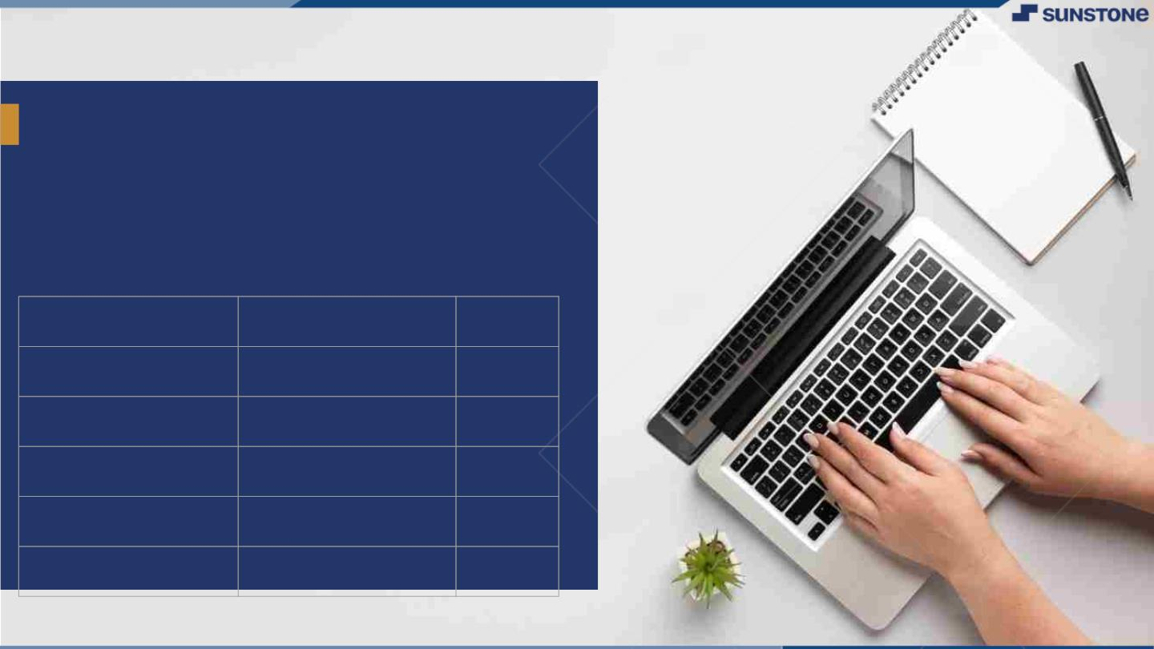
Food Delivery
Website and Application
▪
Food delivery apps are a type of restaurant delivery/ takeout software that connects consumers with local restaurants, grocery stores, convenience stores, etc., by providing a convenient way to order food that's delivered to their doorstep
LMS Username
Name
Batch
au420420205013
Jayalakshmi
CA2
au420420205017
Nandhini
CA2
au420420205006
Divyadharshini
CA2
au420420205020
Priyadharshini
CA2

Slide 3

Taskꢀ-ꢀ2
CreateꢀUIꢀandꢀimplementꢀvariousꢀcomponentsꢀusingꢀreact
●
●
●
SplitꢀdesignꢀintoꢀcomponentsꢀandꢀHigherꢀorderꢀComponents
Defineꢀstructureꢀofꢀtheꢀcomponents
Setꢀtheꢀbasicꢀuiꢀcomponentsꢀwithꢀdummyꢀdata
IntegrateꢀtheꢀAPIsꢀtoꢀfrontendꢀtoꢀensureꢀtheꢀdynamicꢀfeatureꢀofꢀwebsite
●
●
●
●
●
Pointꢀbaseꢀapiꢀtoꢀtheꢀseversꢀbaseꢀurlꢀ
Designꢀapiꢀcallsꢀforꢀeachꢀelementꢀ
Handleꢀerrorsꢀinꢀtheꢀoutput
Renderꢀoutputꢀofꢀapisꢀtoꢀdifferentꢀlowꢀlevelꢀcomponents
Secureꢀcontentꢀofꢀpostꢀapisx
EvaluationꢀMetric:
● 100%ꢀCompletionꢀofꢀtheꢀaboveꢀtasks
Learning Outcome
▪
▪
▪
▪
DevelopingꢀcomplicatedꢀUIꢀusingꢀreactꢀcomponents
Usingꢀpropsꢀdrillingꢀandꢀcontextꢀtoꢀpassꢀvariables
Gettingꢀfamiliarꢀwithꢀdifferentꢀtypeꢀofꢀapiꢀcalls
Handlingꢀdifferentꢀinputꢀdata

Slide 4

Step-WiseꢀDescription
1). Understanding the specific features and functionalities of social media websites include user profiles, news feed, messaging, notifications, etc.
2). Visualize the layout and structure of the interface.
3). Create design elements for different sections like profiles, posts, comments, etc.
4). Organizing files and directories include folders for HTML templates, CSS style sheets, JavaScript files, images, and other assets.
5). Develop a user authentication system for login and registration.
6). Develop the functionality to create, edit, and delete posts.
7). Testing website across different browsers and devices to ensure a consistent experience.
8). Ensure your website is accessible to users with disabilities.
Summaryꢀofꢀyourꢀtask
Building a frontend for a food delivery application involves creating an interface that allows users to browse restaurants, select items, and place orders. Here's a simplified example using HTML, CSS, and JavaScript:.

Slide 5

AssessmentꢀParameter
SetupꢀProjectꢀforꢀCalculatorꢀ
project
Setupꢀbasicꢀstructureꢀofꢀtext-
editorꢀproject
Createꢀaꢀmainꢀcomponentꢀwithꢀtheꢀ
outerꢀstructureꢀofꢀcalculator
Check-List
Createꢀmainꢀcomponentꢀwithꢀ
allꢀfeatureꢀbuttons
Createꢀaꢀbuttonꢀcomponentꢀ
withꢀonꢀclickꢀhandler
Createꢀaꢀjsonꢀobjectꢀtoꢀstoreꢀ
dataꢀforꢀtextꢀeditor
Createꢀaꢀ`ꢀevaluateExpresion`ꢀ
functionꢀtoꢀevaluateꢀvalue
Pushꢀbothꢀcodeꢀtoꢀgithub

Slide 6
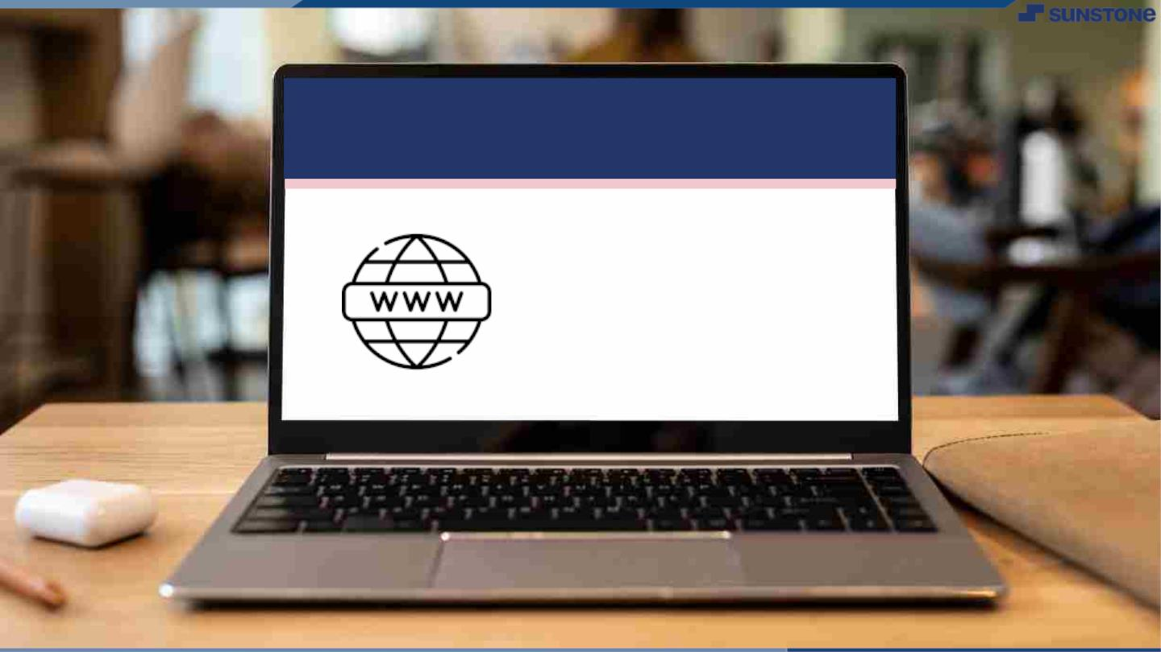
Submission Github
https://github.com/Priyadharshini1023/food-delivery-website.git

Slide 7


